Slide 1
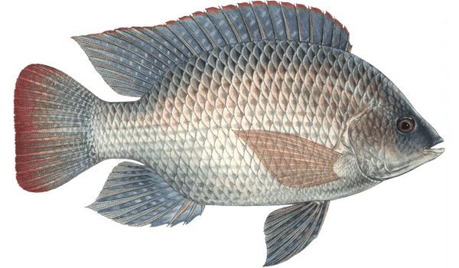
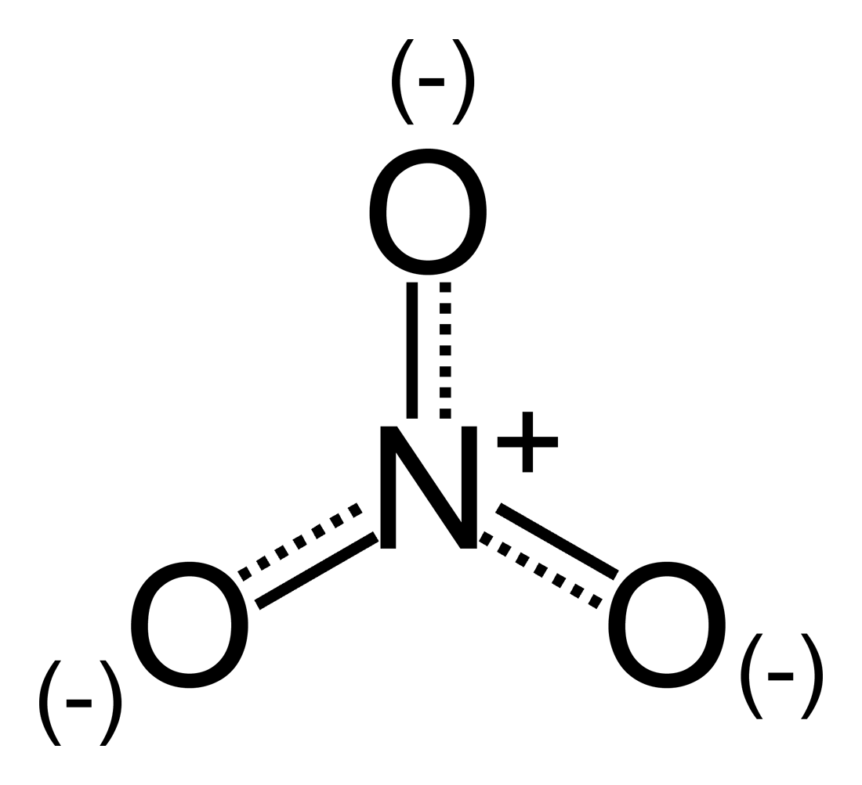

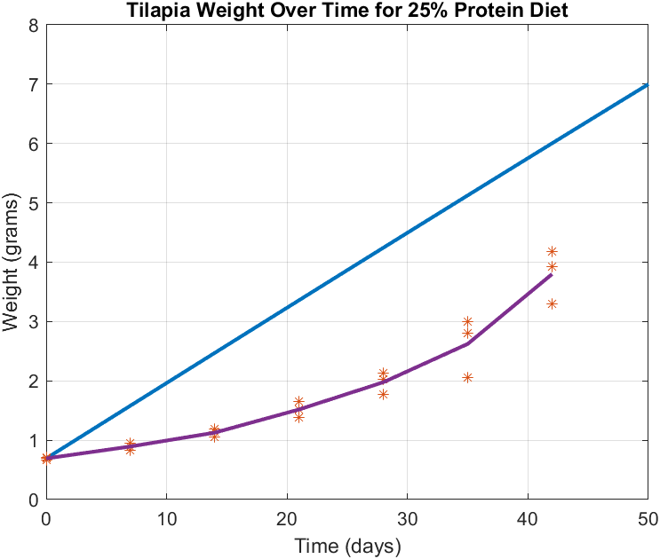
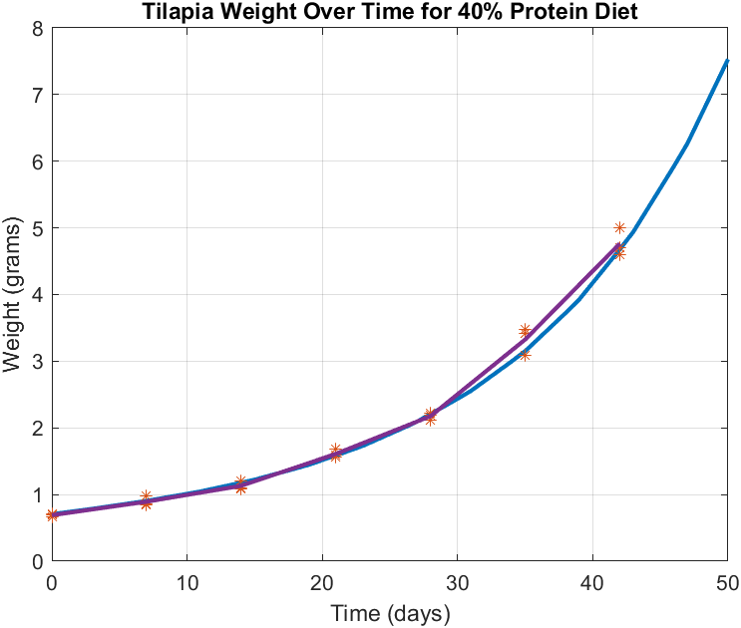
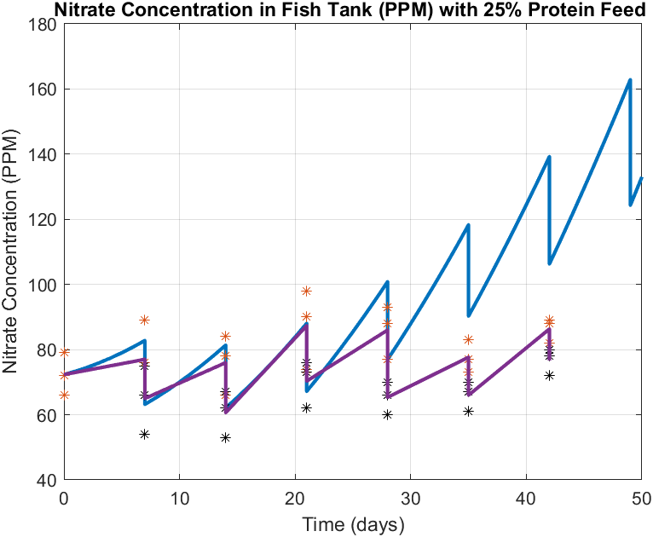
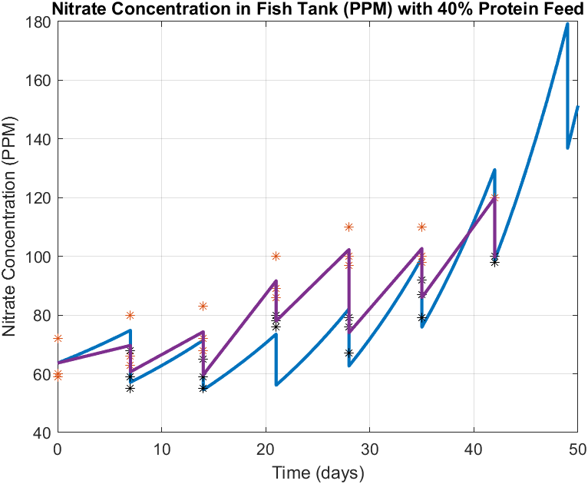
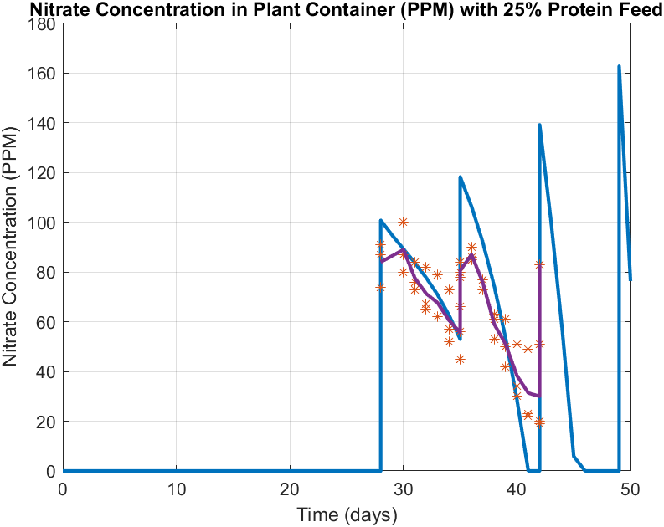
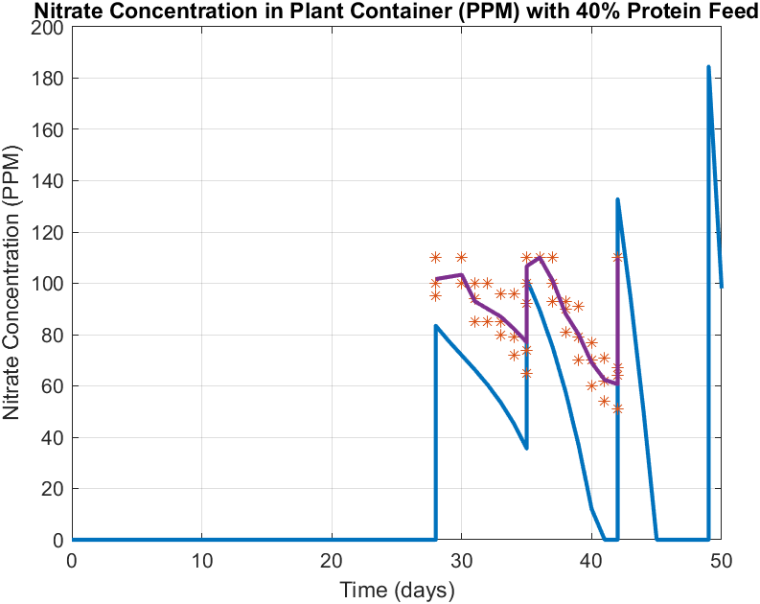
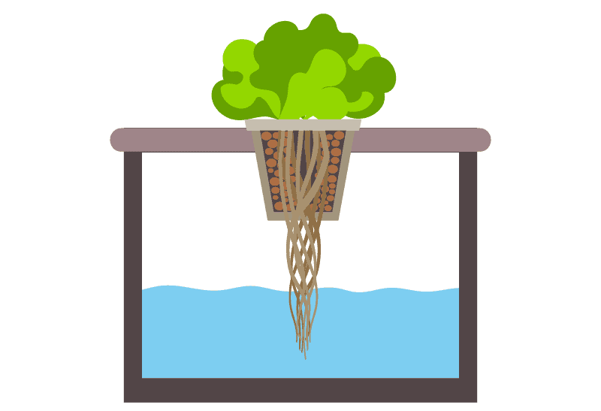
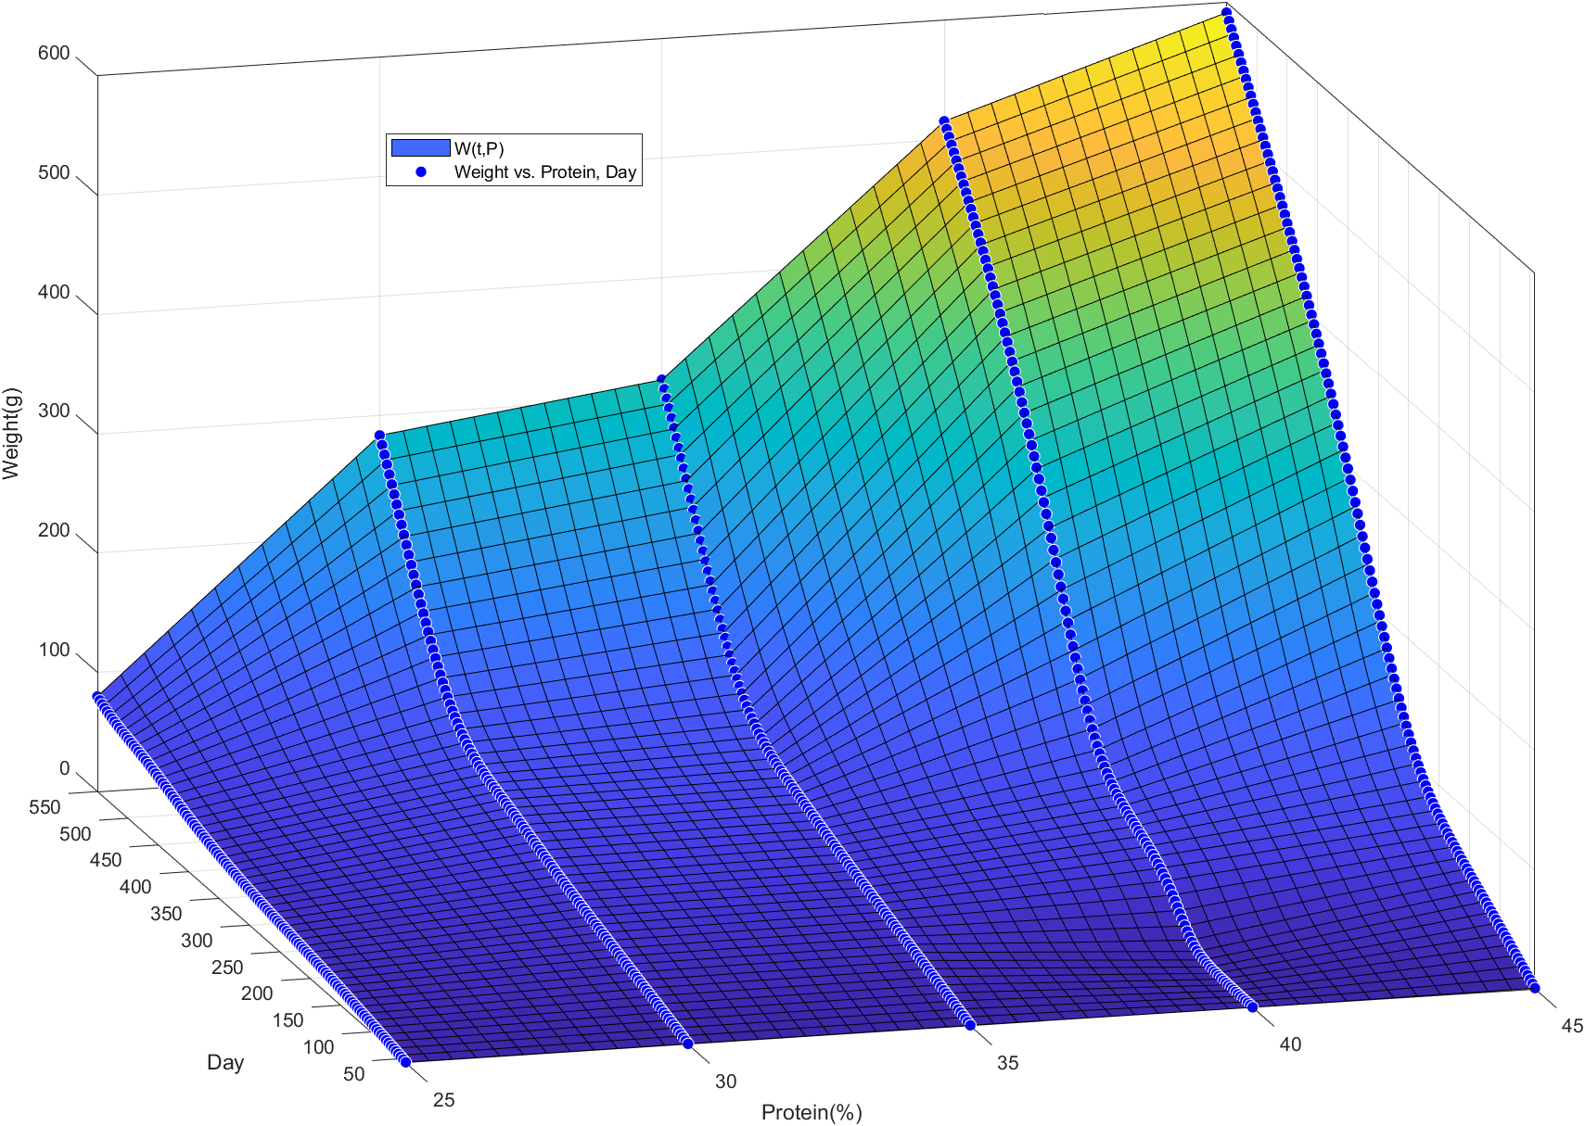
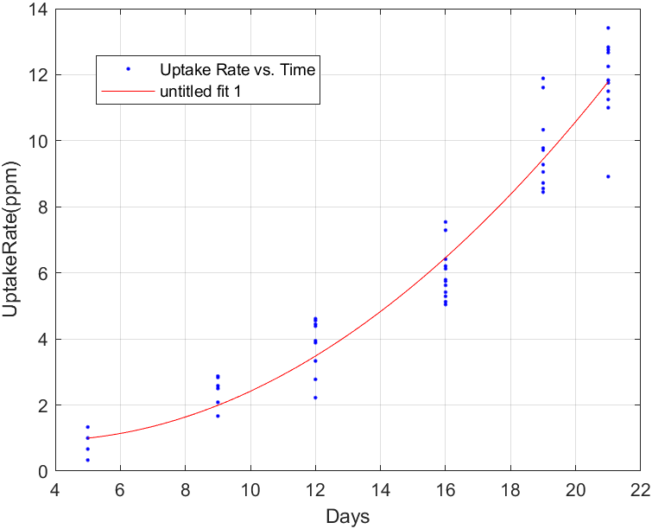
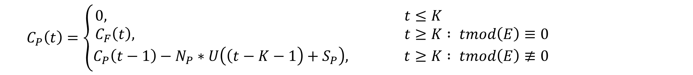
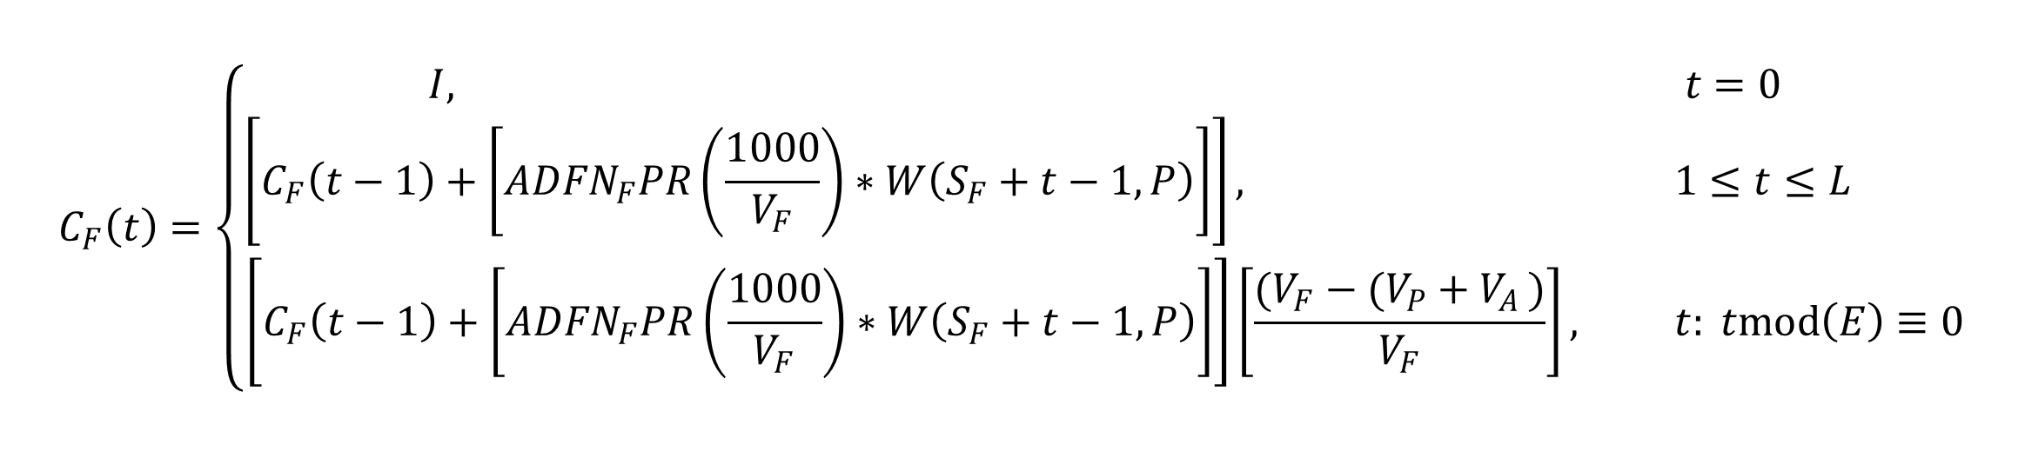

A Recursive MATLAB Model for Nitrate
in a Decoupled Aquaponics System
Evan Gibbs, York College of Pennsylvania
Introduction
Definition of Model
Results of Adjusted Model
The efficiency of aquaponics systems has become a pressing issue, as their use continues to grow. Models have been developed to help understand their nutrient and energy dynamics in the effort to improve these systems (Debrota, K. , 2017, Yogev, U. et. al., 2016).
Nitrogen cycling is crucial in aquaponics systems, as nitrate is a major nutrient desired by plants. Nitrate availability is impacted by many components of aquaponics setup and therefore, is often a nutrient of concern (Wongkiew, S. et. al., 2017).
Models have been developed to analyze nitrate concentrations (and closely related nitrogen-cycle compounds) in coupled aquaponics systems (Shazila, E. et.al., 2022).
The nitrate added to an aquaponics system can be proportionally related to the protein percent of feed fed to the fish of the system (Ebeling, J. M. et.al., 2006). This relation suggests the possibility of improving the efficiency of a system, both plants and fish, by altering the protein content of the feed inputted to the system.
By our considerations, in a coupled aquaponics system, the concentration, C, of nitrate (ppm) can be roughly represented with the differential equation :
The BLUE line is the model prediction. The “*” are scatter plot data of experimental data. The PURPLE line is the mean plotting of the experimental data.
$$\frac{dC}{dt}=\left[\left({ADFN}_{F}PR\right)\left(\frac{1000}{V}\right)∗W\left(t,P\right)\right]−\left[{(N}_{P})(U\left(t\right))\right]$$
However, we can adjust this for our assumed, decoupled system with this recursive, piecewise model for nitrate in the fish aquarium, C_{F} , and nitrate in the kale tub, C_{P} :
$$C_{F}\left(t\right)=\left\{\begin{aligned}I, t=0 \\ \left[C_{F}\left(t−1\right)+\left[{ADFN}_{F}PR\left(\frac{1000}{V_{F}}\right)∗W\left(S_{F}+t−1,P\right)\right]\right], 1≤t≤L \\ \left[C_{F}\left(t−1\right)+\left[{ADFN}_{F}PR\left(\frac{1000}{V_{F}}\right)∗W\left(S_{F}+t−1,P\right)\right]\right]\left[\frac{(V_{F}−(V_{P}+V_{A })}{V_{F}}\right], t: tmod\left(E\right)≡0\end{aligned}\right.$$
Figure 3: Model-predicted, individual tilapia weights (grams) versus experimentally collected weights for 25% diet (n=3).
Figure 4: Model-predicted, individual tilapia weights (grams) versus experimentally collected weights for 40% diet (n=3).
$$C_{P}\left(t\right)=\left\{\begin{aligned}0, &t≤K \\ C_{F}\left(t\right), &t≥K : tmod\left(E\right)≡0 \\ \left.C_{P}\left(t−1\right)−N_{P}∗U\left(\left(t−K−1\right.\right)+S_{P}\right), &t≥K : tmod\left(E\right)≢0\end{aligned}\right.$$
Objective
Where these piecewise equations are processed top-down computationally.
The objective of this project was to create a mathematical model that can predict nitrate concentration in both parts of a decoupled aquaponics system, the fish tank and plant containers. It aims to quantify how differences in protein levels of feed directly translate to the efficiency of decoupled systems.
This definition served as the basis for which we developed a computational model to predict nitrate concentration. The main concern of this model is understanding relative nitrate concentration on a given day, not necessarily continuously.
Figure 6: Model-predicted, individual fish aquarium nitrate concentrations (ppm) versus experimentally collected concentrations for 40% diet where “*” is before dilution and “*” is after (n=3).
Figure 5: Model-predicted, individual fish aquarium nitrate concentrations (ppm) versus experimentally collected concentrations for 25% diet where “*” is before dilution and “*” is after (n=3).
Considerations of Model
Creation and Implementation of Model
Five main components to consider…
1. Blue Tilapia (Oreochromis aureus)
2. Hybrid Winterbor F1 Kale (Brassica oleracea var. Sabellica)
3. Bacteria of Fish Aquarium
4. Aquarium Water
5. Kale Tub Water
Variables and Functions of Model:
A = Conversion efficiency for ammonia into nitrate. (A = 1.00) (100%)
C_{F}(t) = Concentration of nitrate (ppm) in fish aquarium. (C_{F}(0) = I)
C_{P}(t) = Concentration of nitrate (ppm) in kale tub. (C_{P} (0) = 0)
D = Percent of nitrate remaining after denitrification in aquarium (%). (D = 1.00) (100%)
E = Transfer rate of water into kale tubs from aquarium (days). (E = 7)
F = Percent of bodyweight of feed fed to tilapia in given day (%). (F = 0.05, 0.03, 0.025, 0.015) (5%, 3%, 2.5%, 1.5%)
I = Initial nitrate concentration (ppm) of aquarium. (25%: I = 72.6, 40%: I = 62.3)
K = Starting day of kale, where K is a positive multiple of E. (K = 28)
L = Length of experiment (days). (L = 50)
N_{F} = Number of tilapia. (N_{F} = 18)
N_{P} = Number of plants. (N_{P} = 6)
P = Protein percent of tilapia feed. (P = 0.25, 0.40) (25%, 40%)
R = Protein transfer rate from protein to ammonia. (R = 0.092 adjusted to R = 0.420)
S_{F} = Starting age of tilapia (days). (Determined by W(t,P))
S_{P} = Starting age of kale (days). (Determined by U(t))
U(t) = Uptake rate of nitrate (ppm) for one kale plant on given day, t.
V_{A} = Volume of additional water removed during water transfer (liters). (V_{A} = 9)
V_{F} = Volume of fish aquarium (liters). (V_{F} = 76)
V_{P} = Volume of kale tub (liters). (V_{P} = 9)
W(t,P) = Weight of one tilapia (in grams) on given day, t, while being fed food of protein percent, P. (W(0,25) = W(0,40) = 0.69)
Important Assumptions to Note:
1. Conversion of ammonia to nitrate is 1:1 (follows from Ebeling, J. M. et.al., 2006)
2. All protein-entered ammonia is converted during a single day, not by a determined rate. It then follows that the given nitrate concentration determined by the model is suited for only integer days, as rate is unknown, but maximum amount of nitrate increase is capped.
c
To construct the mathematical model computationally, we developed an approximately 200-line MATLAB code that can be readily molded for various scenarios and conditions (assuming available information).
INITIAL CONDITIONS FROM USER (See Considerations of Model)
Figure 7: Model-predicted, individual kale tub nitrate concentrations (ppm) versus experimentally collected concentrations for 25% diet (n=3).
Figure 8: Model-predicted, individual kale tub nitrate concentrations (ppm) versus experimentally collected concentrations for 40% diet (n=3).
Conclusion and Future Research
With R adjustment, the projections follow well to the model predictions for nitrate in the fish aquarium (especially for 40%).
The overshooting of the 25% model for the aquarium is consistent with the over-projection of W(t,P) for 25%.
Kale uptake rates are overestimated, which is also consistent with the conditions of our current kale in comparison to sample data.
Future research will focus on continuing our ongoing collection of experimental data, as well as fine-tuning the already known discrepancies of the model.
Figure 1: Linearly interpolated MATLAB fit used for predicting fish weight (grams) based on protein percentage fed. Data for the model fit was collected from our Spring 2023 experiment and Hafedh, Y. S. A,1999.
Figure 2: Polynomial regression MATLAB fit used for predicting kale uptake rate (ppm/day) based on determined age. Data for the model fit was collected from our Summer 2023 experiment.
Sources Cited
L Times
Debrota, K. (2017). Mechanistic Modeling of an Aquaponic Controlled-Environment Agriculture System: Nutrient and Water Dynamics, Harvest Productivity, and Waste Treatment A Dissertation Presented to The Academic Faculty. https://repository.gatech.edu/server/api/core/bitstreams/25032e72-38e1-4c8f-9428-098cf650455e/content
Ebeling, J. M., Timmons, M. B., & Bisogni, J. J. (2006). Engineering analysis of the stoichiometry of photoautotrophic, autotrophic, and heterotrophic removal of ammonia–nitrogen in aquaculture systems. Aquaculture, 257(1-4), 346–358. https://doi.org/10.1016/j.aquaculture.2006.03.019
Hafedh, Y. S. A. (1999). Effects of dietary protein on growth and body composition of Nile tilapia, Oreochromis niloticus L. Aquaculture Research, 30(5), 385–393. https://doi.org/10.1046/j.1365-2109.1999.00343.x
Shazila, E., Roni, M., & Ali, A. (2022). Mathematical Modelling of an Aquaponics System in the Presence of Nitrite. Proceedings of Math and Science, 9(9), 49–63.
Wongkiew, S., Hu, Z., Chandran, K., Lee, J. W., & Khanal, S. K. (2017). Nitrogen transformations in aquaponic systems: A review. Aquacultural Engineering, 76, 9–19. https://doi.org/10.1016/j.aquaeng.2017.01.004
Yogev, U., Barnes, A., & Gross, A. (2016). Nutrients and Energy Balance Analysis for a Conceptual Model of a Three Loops off Grid, Aquaponics. Water, 8(12), 589. https://doi.org/10.3390/w8120589
Images:
Blue Tilapia, 2023. Bingcom. [accessed 2023 Apr 27]. https://th.bing.com/th/id/OIP.qRP_H7SE8caSFVX-y9V6JQHaE7?pid=ImgDet&rs=1.
The Krafty Method of Hydroponics. (n.d.). https://uponics.com/wp-content/uploads/2018/02/Kratky-Method-600x504.jpg
L Times
RUN MODEL CODE
After L Times
Graph of W(t,P)
Acknowledgments
Experimental Data
Output of Model Graphed
Graph of C_{F}
I would like to thank the York College Biology Department for making this research possible and providing the resources for our ongoing study. I would also like to thank Dr. Smith, Dr. Blanding, and Dr. Kaplan for their assistance in portions of this project. Lastly, I am extremely grateful for Dr. Nolan’s support and guidance throughout the entirety of this research project and am excited to continue working alongside her.
Graph of C_{P}
All research activities in this study were approved by the York College of Pennsylvania Institutional Animal Care and Use Committee (IACUC).

